Slide 1
Relevant Costs and Benefits
A relevant cost is a cost that differs between alternatives.
A relevant benefit is a benefit that differs between alternatives.
1
2
Notes:
Costs that differ between alternatives are called relevant costs. Benefits that differ between alternatives are relevant benefits.

Slide 2
Identifying Relevant Costs
An avoidable cost is a cost that can be eliminated, in whole or in part, by choosing one alternative over another. Avoidable costs are relevant costs. Unavoidable costs are irrelevant costs.
Two broad categories of costs are never relevant in any decision. They include:
  Sunk costs.
  A future cost that does not differ between the alternatives.
Notes:
An avoidable cost is a cost that can be eliminated, in whole or in part, by choosing one alternative over another. Avoidable costs are relevant costs. Unavoidable costs are irrelevant costs.
Two broad categories of costs are never relevant in any decision:
A sunk cost is a cost that has already been incurred and cannot be avoided regardless of what a manager decides to do.
A future cost that does not differ between alternatives is never relevant in a decision.

Slide 3

Decision Making: A Two-Step Process
Step 1
Eliminate costs and benefits that do not differ between alternatives.
Use the remaining costs and benefits that differ between alternatives in making the decision. The costs that remain are the differential, or avoidable, costs.
Step 2
Notes:
Decision making is a two-step process.
The first step is to eliminate costs and benefits that do not differ between alternatives. These irrelevant costs consist of sunk costs and future costs that do not differ between alternatives.
The second step is to use the remaining costs and benefits that do differ between alternatives in making the decision. The costs that remain are the differential, or avoidable, costs.

Slide 4

Different Costs for Different Purposes
Costs that are relevant in one decision situation may not be relevant in another context. Thus, in each decision situation, the manager must examine the data at hand and isolate the relevant costs.
Notes:
Costs that are relevant in one decision situation may not be relevant in another context. Thus, in each decision situation, the manager must examine the data at hand and isolate the relevant costs.

Slide 5
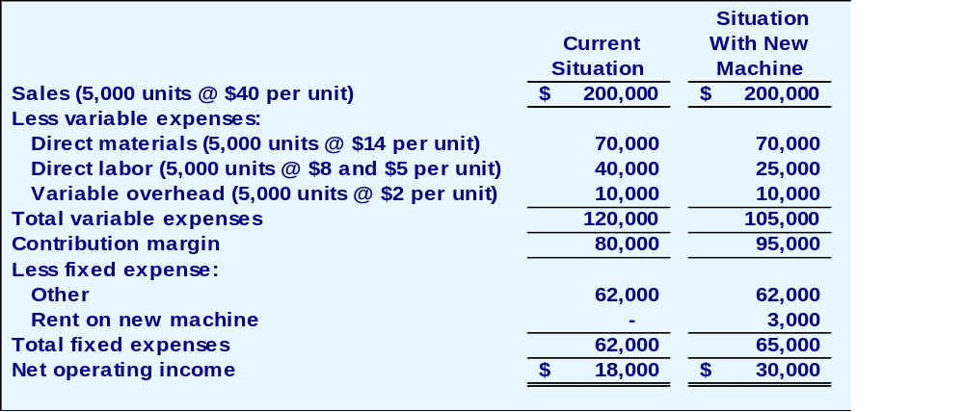
Total and Differential Cost Approaches
The management of a company is considering a new labor saving machine that rents for $3,000 per year. Data about the company’s annual sales and costs with and without the new machine are:
Notes:
Assume the following information for a company considering a new labor-saving machine that rents for $3,000 per year.
The total approach requires constructing two contribution format income statements – one for each alternative.
The difference between the two income statements of $12,000 equals the differential benefits shown at the bottom of the right-hand column.

Slide 6
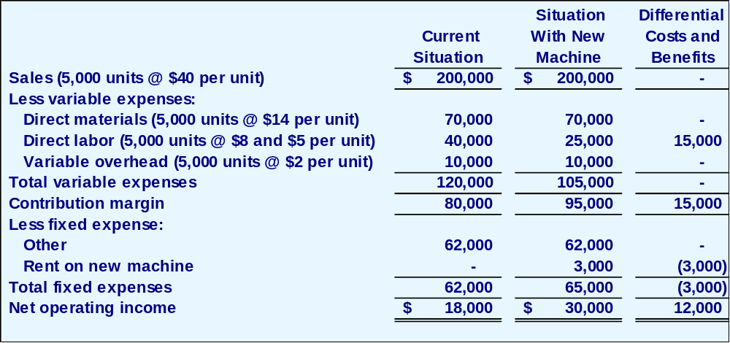
Total and Differential Cost Approaches
The management of a company is considering a new labor saving machine that rents for $3,000 per year. Data about the company’s annual sales and costs with and without the new machine are:
Notes:
Assume the following information for a company considering a new labor-saving machine that rents for $3,000 per year.
The total approach requires constructing two contribution format income statements – one for each alternative.
The difference between the two income statements of $12,000 equals the differential benefits shown at the bottom of the right-hand column.

Slide 7

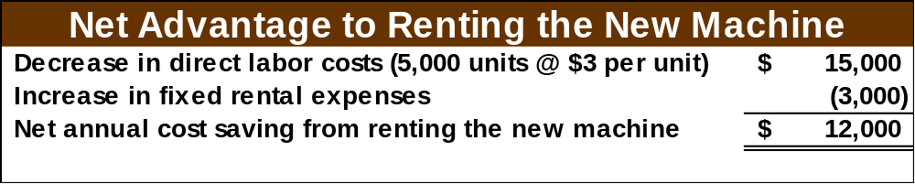
Total and Differential Cost Approaches
As you can see, the only costs that differ between the alternatives are the direct labor costs savings and the increase in fixed rental costs.
We can efficiently analyze the decision by
looking at the different costs and revenues
and arrive at the same solution.
Notes:
The most efficient means of analyzing this decision is to use the differential approach to isolate the relevant costs and benefits as shown.

Slide 8
Total and Differential Cost Approaches
Using the differential approach is desirable for two reasons:
Only rarely will enough information be available to prepare detailed income statements for both alternatives.
Mingling irrelevant costs with relevant costs may cause confusion and distract attention away from the information that is really critical.
Notes:
Using the differential approach is desirable for two reasons:
First, only rarely will enough information be available to prepare detailed income statements for both alternatives.
Second, mingling irrelevant costs with relevant costs may cause confusion and distract attention away from the information that is really critical.

Slide 9
Add or drop a business segment
Notes:
Learning objective number 2 is to prepare an analysis showing whether a product line or other business segment should be added or dropped.

Slide 10
make or buy
Notes:
Learning objective number 3 is to prepare a make or buy analysis.

Slide 11
Accept or Reject a special order
Notes:
Learning objective number 4 is to prepare an analysis showing whether a special order should be accepted.

Slide 12
Most profitable use of a constrained resource.
Notes:
Learning objective number 5 is to determine the most profitable use of a constrained resource.

Slide 13
sell joint products at the split-off point or processed further
Notes:
Learning objective number 7 is to prepare an analysis showing whether joint products should be sold at the split-off point or processed further.

